Slide 1

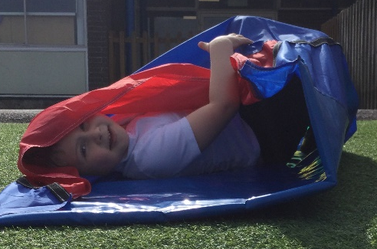
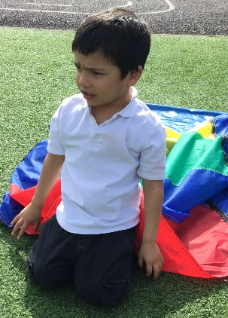
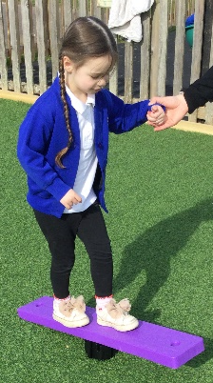
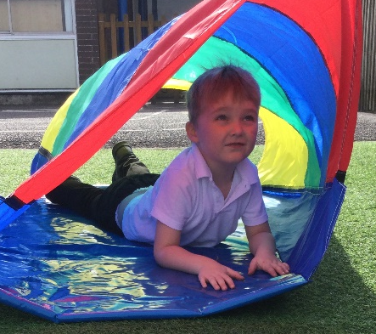
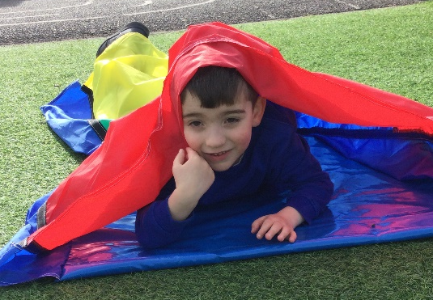
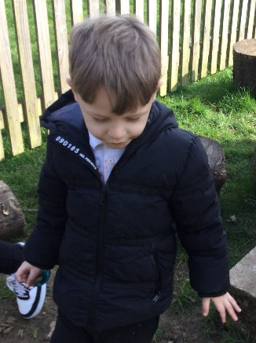
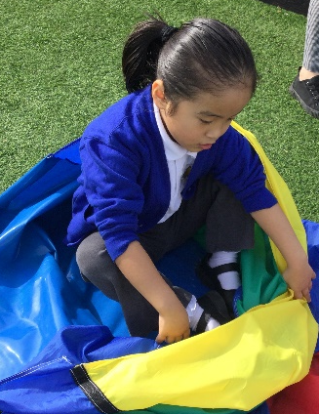
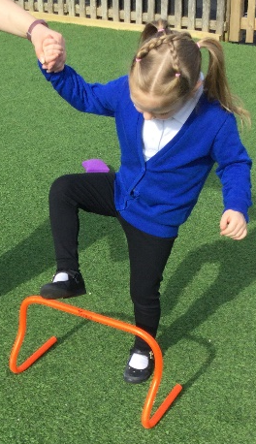
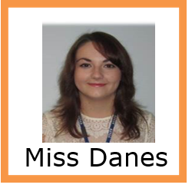
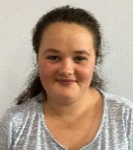
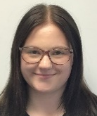
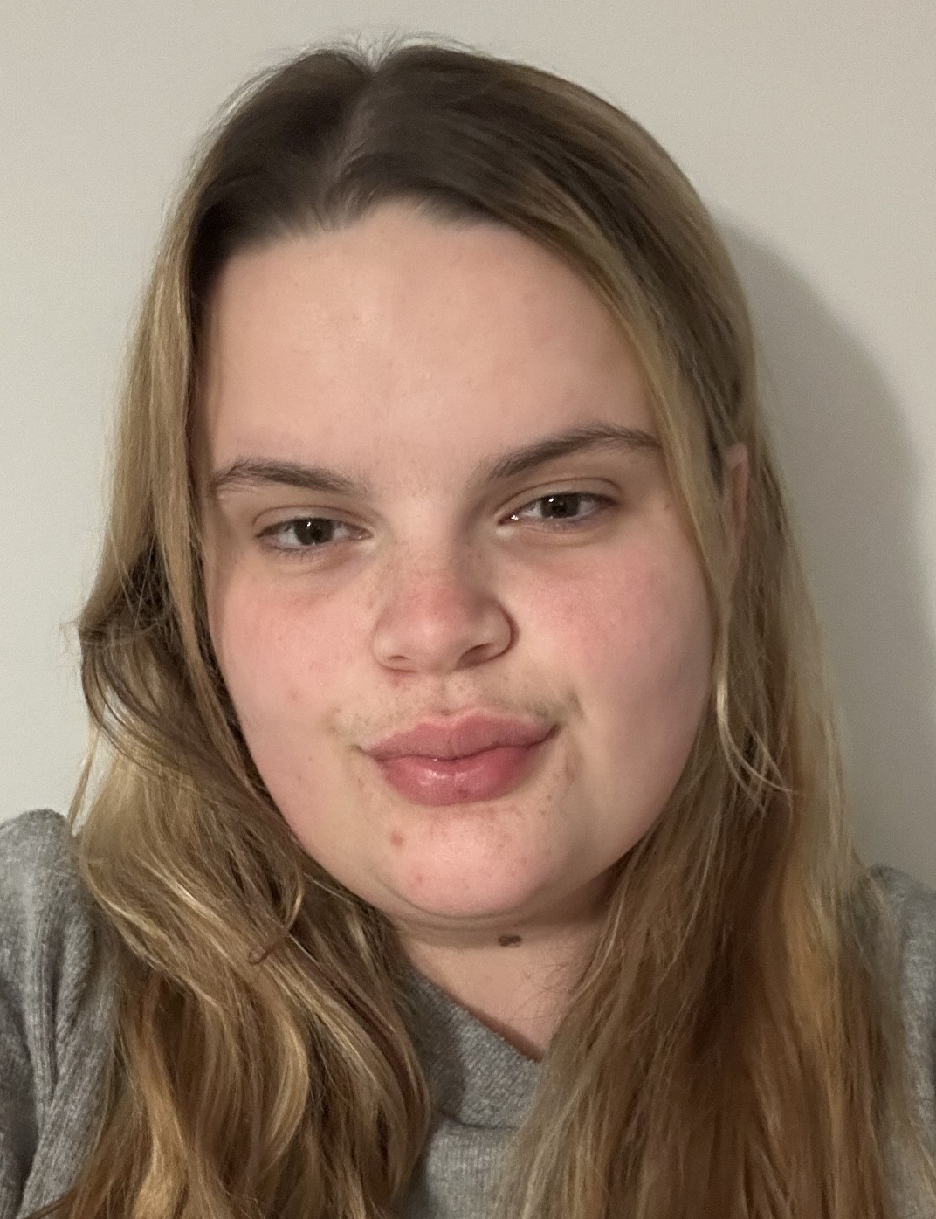
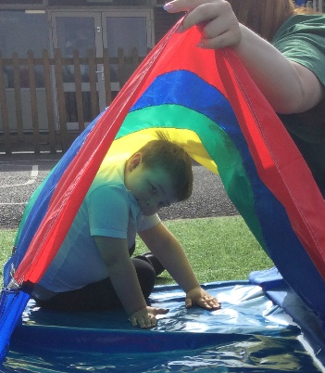
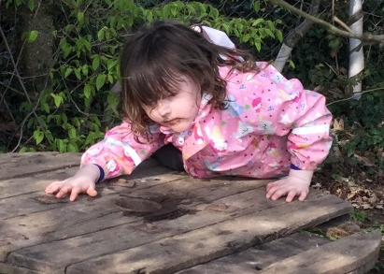
Newsletter
Maple Class
Friday
27th March 2026
Celebration assembly
Award: Freddie for lots of brilliant clapping throughout the week
School rule award: Alfie for sharing the sensory toys box with peers
It was great to see so many of you at the Art Gallery on Tuesday, we hope you enjoyed it.
Any feedback on the event would be appreciated so we can keep similar events running during the school year for you to share some experiences with your children.
We will be having a staffing change after Easter. Miss Cavanagh will be moving next door to help Holly Class and we will be welcoming Miss Addaway to Maple.
We hope you all have a lovely Easter Holiday and look forward to seeing you again on
Monday 13th April.
Miss Phelps
at lunchtime
Miss Middleton
Miss Goddard
Miss Addaway

